Slide 1
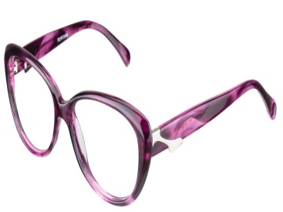
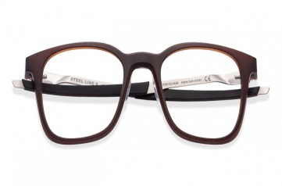

A CASE STUDY ON
Done By : Ankita More
Guided By : Rasika Mam

Slide 2
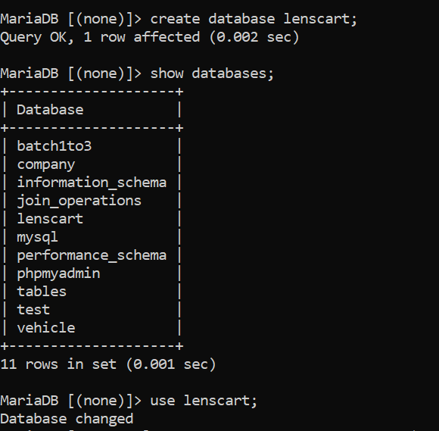
Create database
Query : create database lenscart;

Slide 3
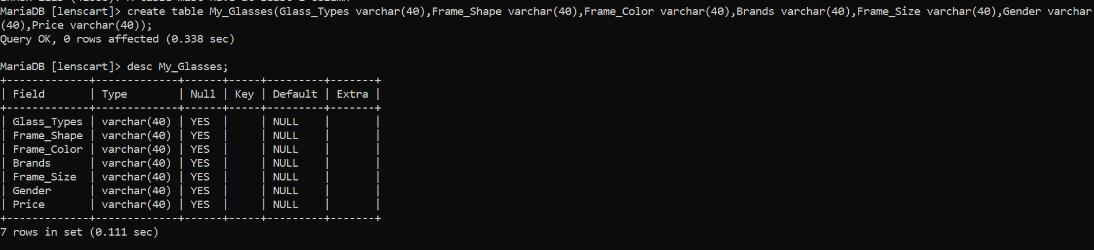
Create a table
Query
To create table: create table My_Glasses(Glass_Types varchar(40),Frame_Shape varchar(40),Frame_Color varchar(40),Brands varchar(40),Frame_Size varchar(40),Gender varchar(40),Price varchar(40));
To show table: desc My_Glasses;

Slide 4
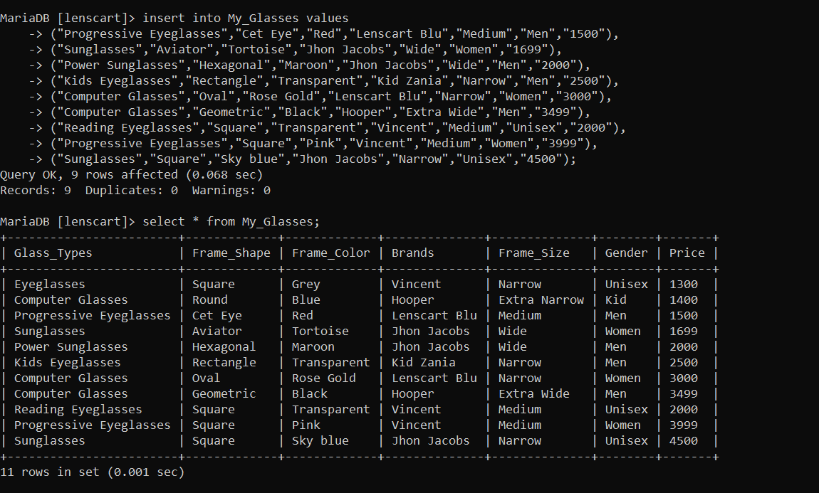
Table for Information of Lenses
Query
To insert values: insert into My_Glasses values(……);
To see all data : select * from My_Glasses;

Slide 5
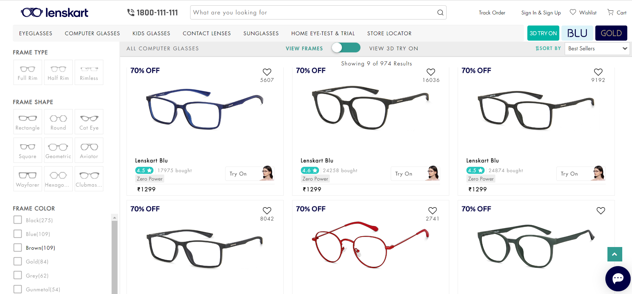
To see all products
Query : select * from My_Glasses;

Slide 6
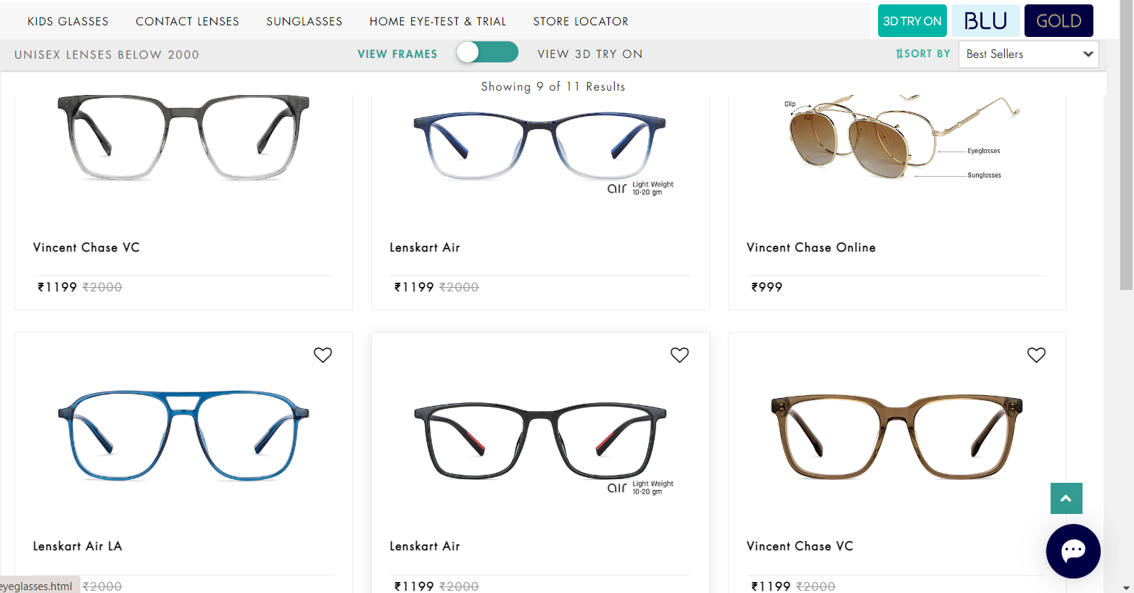
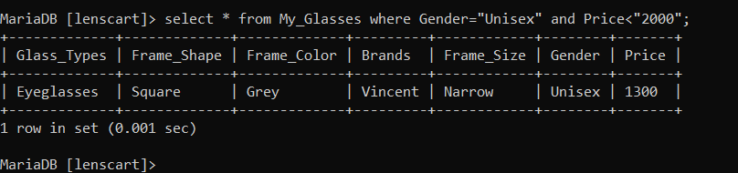
If you are looking for Unisex Specs below Rs.2000
Query : select * from My_Glasses where Gender=“Unisex” and Price<“2000”;

Slide 7
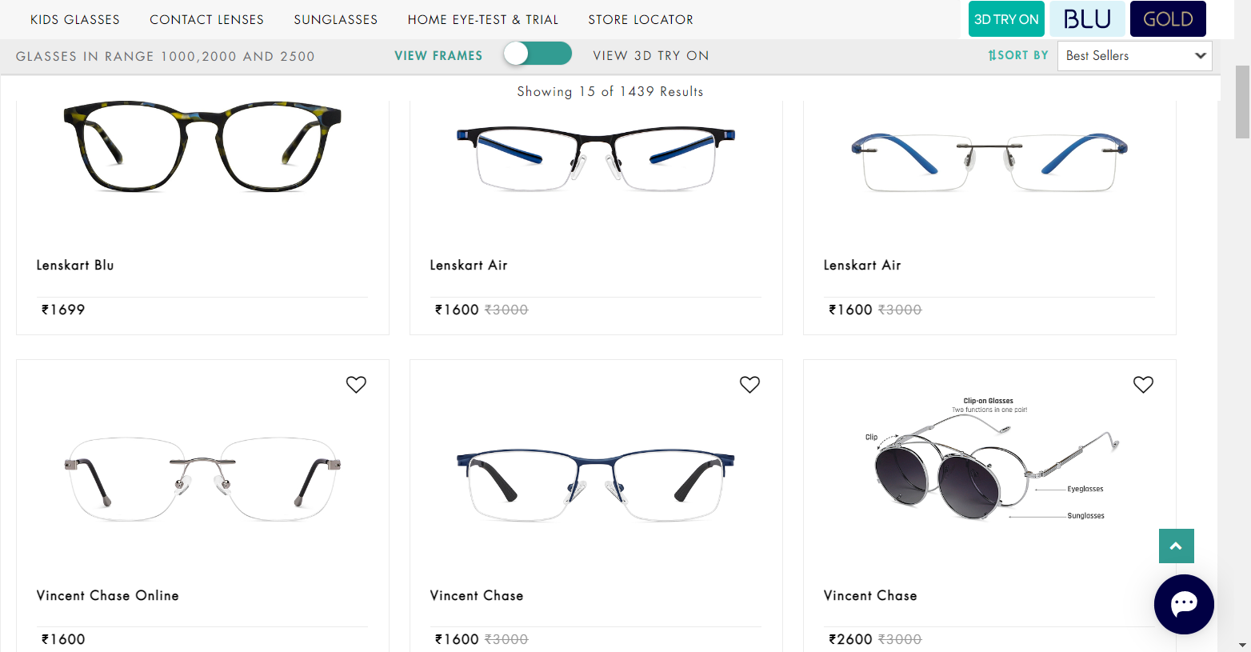
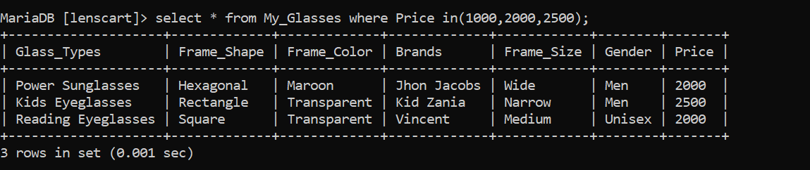
Glasses in range 1000,2000,2500
Query : select * from My_Glasses where Price in(1000,2000,2500);

Slide 8
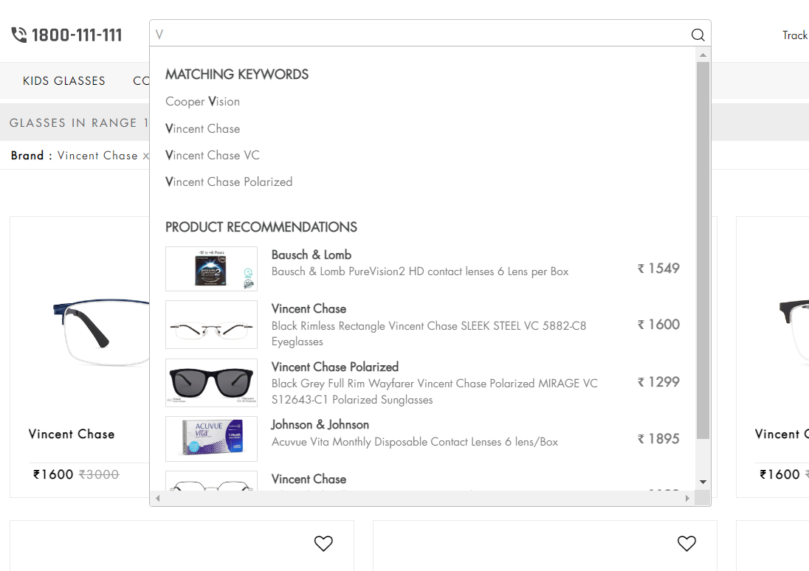
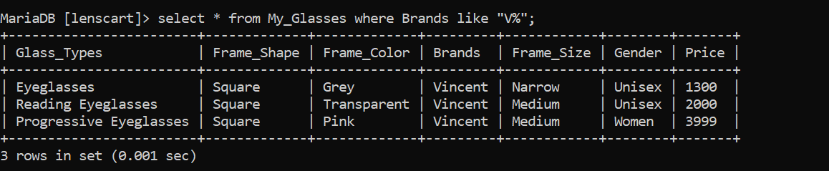
If you are searching for Vincent brand
Query : select * from My_Glasses where Brands like “V”%;

Slide 9
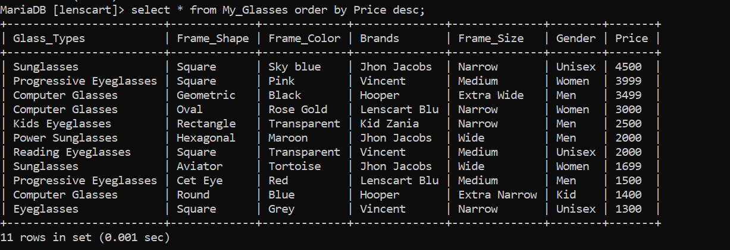
Order by High to Low
Query: select * from My_Glasses order by Price desc;

Slide 10
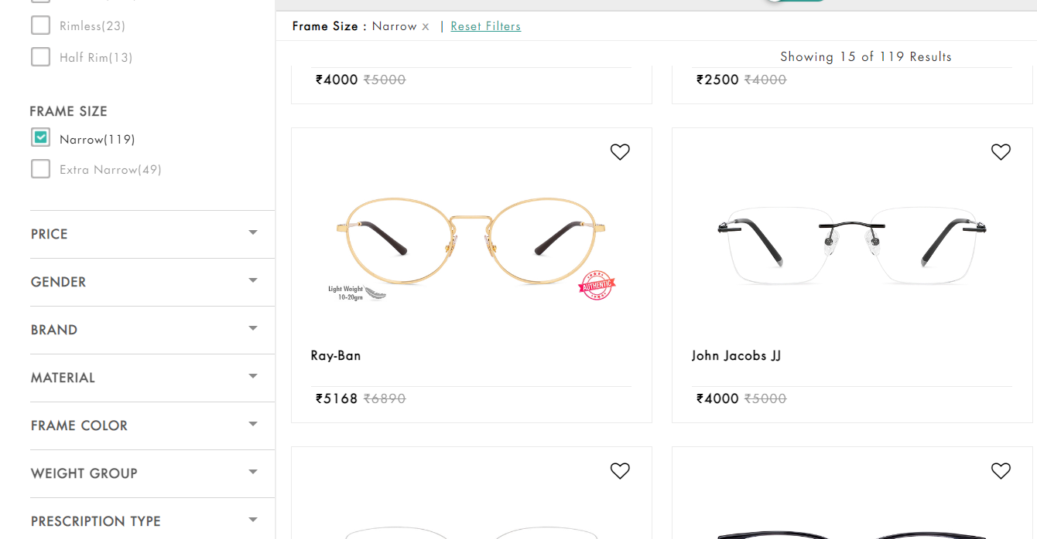
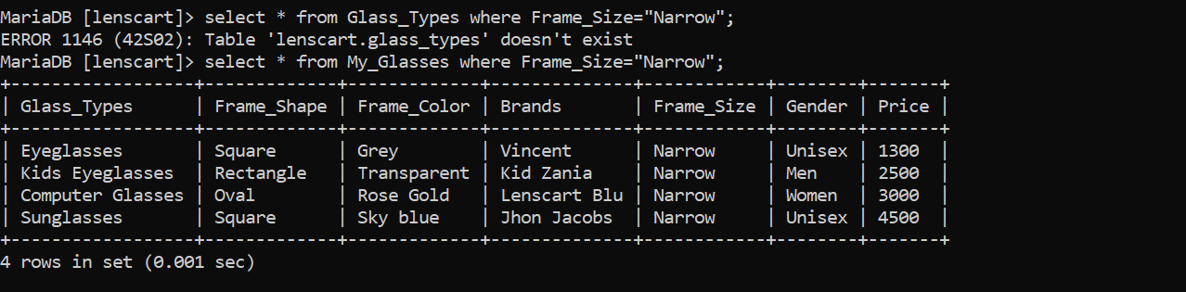
Can search for narrow sized lenses
Query : select * from My_Glasses where Frame_Size=“Narrow”;

Slide 11
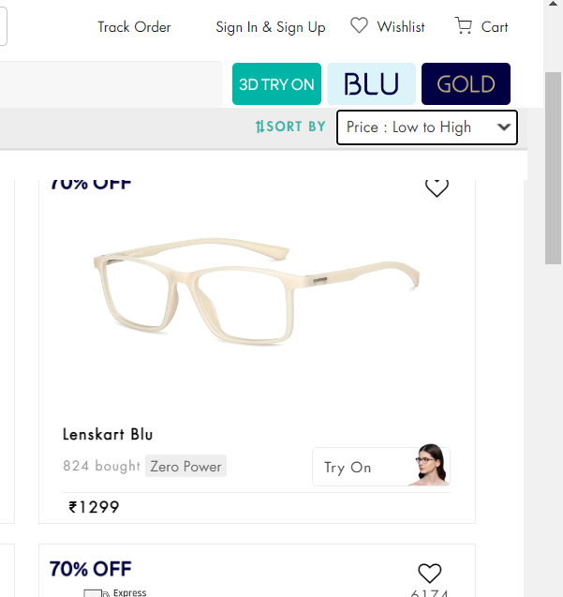
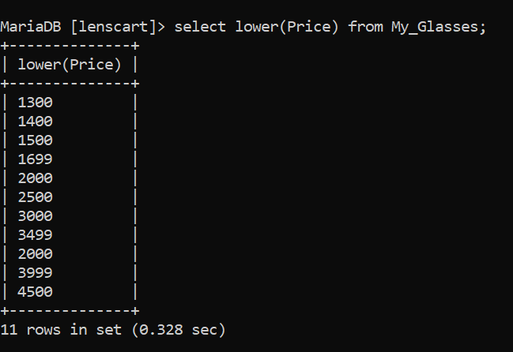
Apply filter for Low to High price;
Query: select lower(Price) from My_Classes;

Slide 12
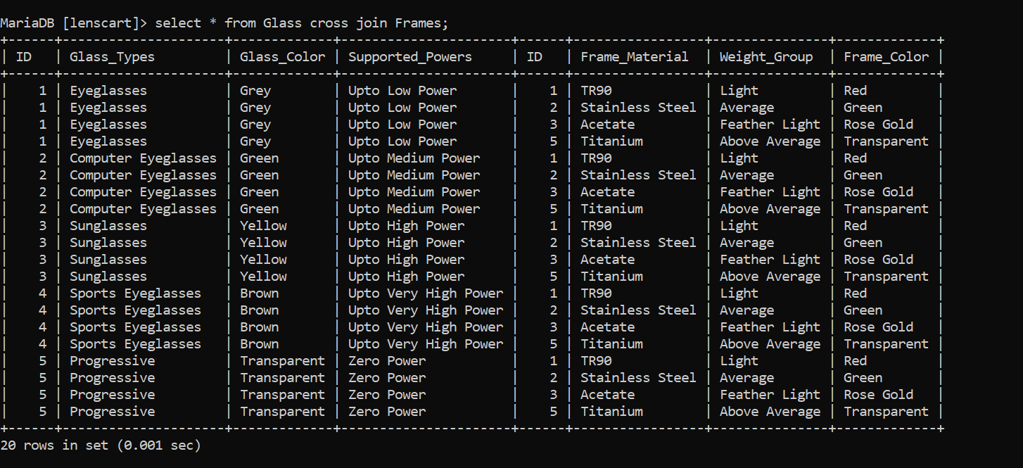
Cross Join of Glass and Frames
Query : select * from Glass cross join Frames;

Slide 13
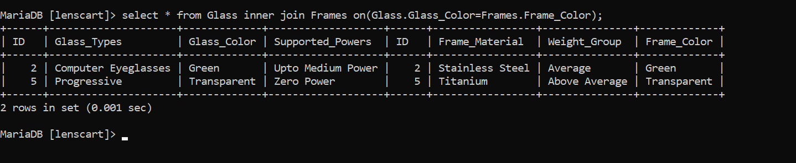
Inner join query for same color of Glass and Frame
Query : select * from Glass inner join Frames on(Glass.Glass_Color=Frames.Frame_Color

Slide 14
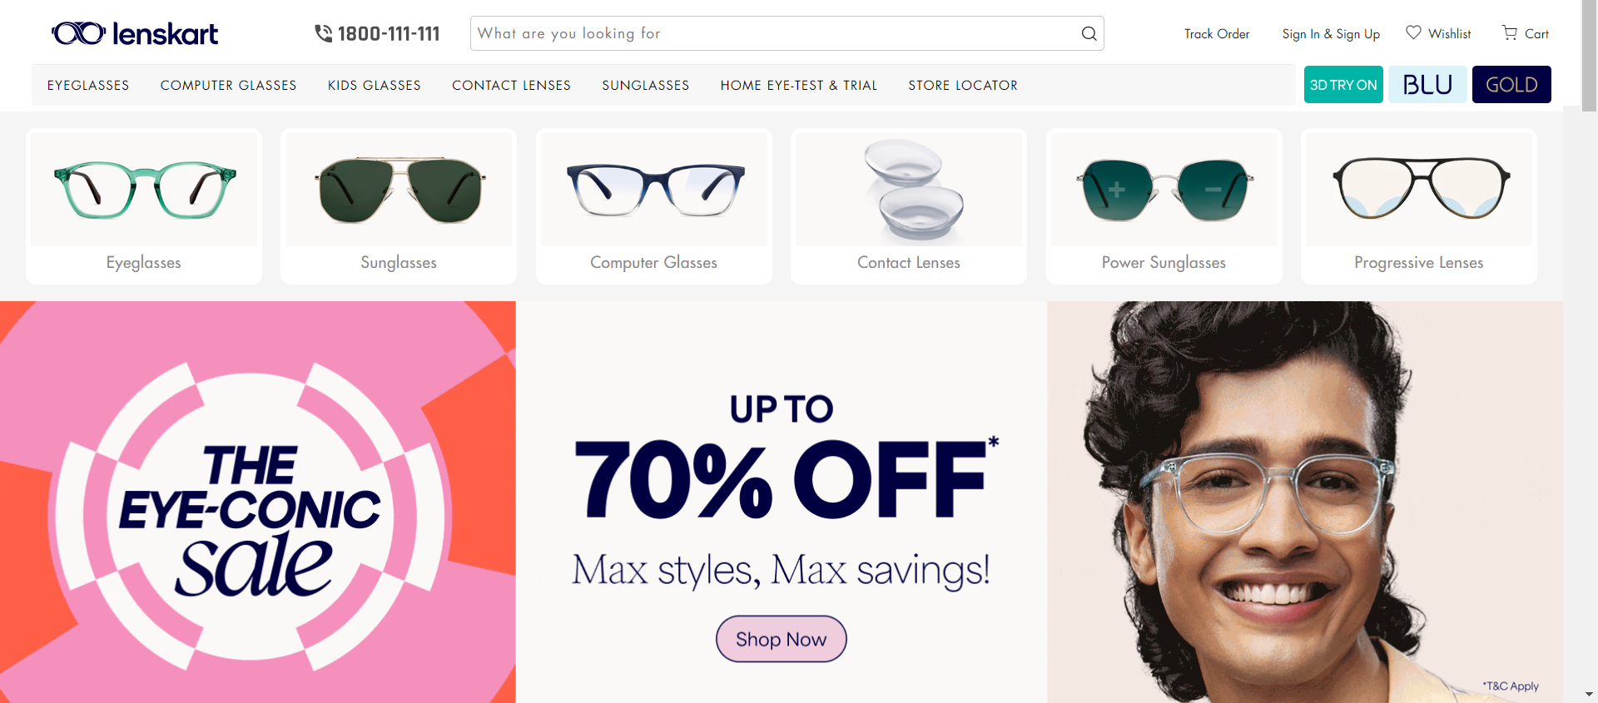
For discount on Lenses

Slide 15
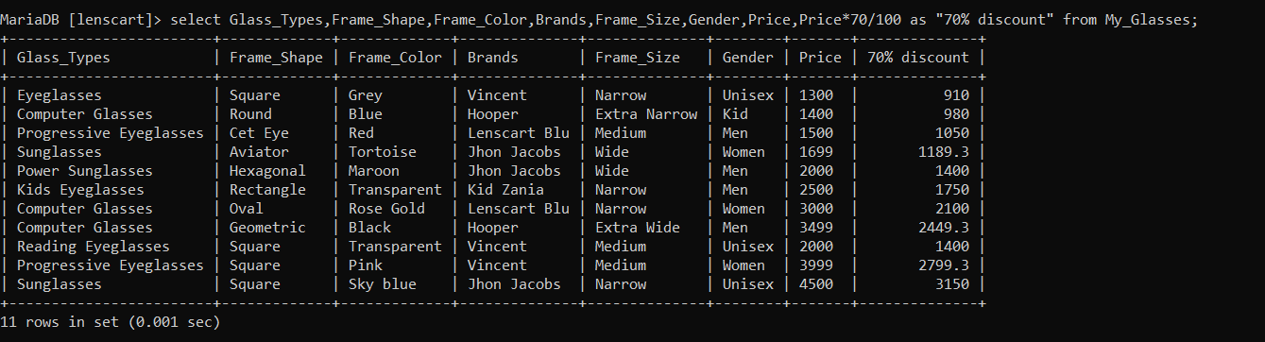
Query :
select Glass_Types,Frame_Shape,Frame_Color,Brands,Frame_Size,Gender,Price,Price*70/100 as "70% discount" from My_Glasses;

Slide 16
Thank You!!

